Slide 1
CHAPTER 5
Data Types

Slide 2
CHAPTER 6 TOPICS
Introduction
Primitive Data Types
Character String Types
User-Defined Ordinal Types
Array Types
Associative Arrays
Record Types
Union Types
Pointer and Reference Types
1-<number>

Slide 3
INTRODUCTION
A data type defines a collection of data objects and a set of predefined operations on those objects
A descriptor is the collection of the attributes of a variable
An object represents an instance of a user-defined (abstract data) type
One design issue for all data types: What operations are defined and how are they specified?
1-<number>

Slide 4
PRIMITIVE DATA TYPES
Almost all programming languages provide a set of primitive data types
Primitive data types: Those not defined in terms of other data types
Some primitive data types are merely reflections of the hardware
Others require little non-hardware support
1-<number>

Slide 5
PRIMITIVE DATA TYPES: INTEGER
Almost always an exact reflection of the hardware so the mapping is trivial
There may be as many as eight different integer types in a language
Java’s signed integer sizes: byte, short, int, long
1-<number>

Slide 6
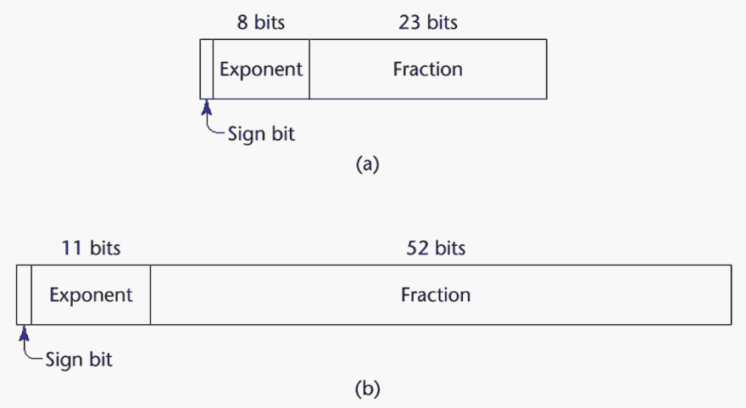
PRIMITIVE DATA TYPES: FLOATING POINT
Model real numbers, but only as approximations
Languages for scientific use support at least two floating-point types (e.g., float and double; sometimes more
Usually exactly like the hardware, but not always
IEEE Floating-Point
Standard 754
1-<number>

Slide 7
PRIMITIVE DATA TYPES: DECIMAL
For business applications (money)
  Essential to COBOL
  C# offers a decimal data type
Store a fixed number of decimal digits
Advantage: accuracy
Disadvantages: limited range, wastes memory
1-<number>

Slide 8
PRIMITIVE DATA TYPES: BOOLEAN
Simplest of all
Range of values: two elements, one for “true” and one for “false”
Could be implemented as bits, but often as bytes
  Advantage: readability
1-<number>

Slide 9
PRIMITIVE DATA TYPES: CHARACTER
Stored as numeric codings
Most commonly used coding: ASCII
An alternative, 16-bit coding: Unicode
  Includes characters from most natural languages
  Originally used in Java
  C# and JavaScript also support Unicode
1-<number>

Slide 10
CHARACTER STRING TYPES
Values are sequences of characters
Design issues:
  Is it a primitive type or just a special kind of array?
  Should the length of strings be static or dynamic?
1-<number>

Slide 11
CHARACTER STRING TYPES OPERATIONS
Typical operations:
  Assignment and copying
  Comparison (=, >, etc.)
  Catenation
  Substring reference
  Pattern matching
1-<number>

Slide 12
CHARACTER STRING TYPE IN CERTAIN LANGUAGES
C and C++
  Not primitive
  Use char arrays and a library of functions that provide operations
SNOBOL4 (a string manipulation language)
  Primitive
  Many operations, including elaborate pattern matching
Java
  Primitive via the String class
1-<number>

Slide 13
CHARACTER STRING LENGTH OPTIONS
Static: COBOL, Java’s String class
Limited Dynamic Length: C and C++
  In C-based language, a special character is used to indicate the end of a string’s characters, rather than maintaining the length
Dynamic (no maximum): SNOBOL4, Perl, JavaScript
Ada supports all three string length options
1-<number>

Slide 14
CHARACTER STRING TYPE EVALUATION
Aid to writability
As a primitive type with static length, they are inexpensive to provide--why not have them?
Dynamic length is nice, but is it worth the expense?
1-<number>

Slide 15
CHARACTER STRING IMPLEMENTATION
Static length: compile-time descriptor
Limited dynamic length: may need a run-time descriptor for length (but not in C and C++)
Dynamic length: need run-time descriptor; allocation/de-allocation is the biggest implementation problem
1-<number>

Slide 16
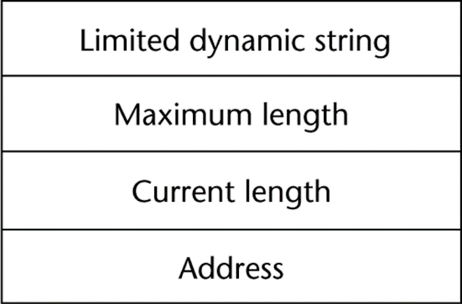
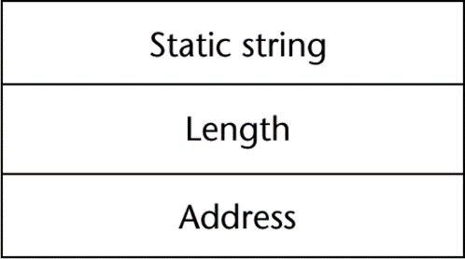
COMPILE- AND RUN-TIME DESCRIPTORS
Compile-time descriptor for static strings
Run-time descriptor for limited dynamic strings
1-<number>

Slide 17
USER-DEFINED ORDINAL TYPES
An ordinal type is one in which the range of possible values can be easily associated with the set of positive integers
Examples of primitive ordinal types in Java
  integer
  char
  boolean
1-<number>

Slide 18
ENUMERATION TYPES
All possible values, which are named constants, are provided in the definition
C# example
  enum days {mon, tue, wed, thu, fri, sat, sun};
Design issues
  Is an enumeration constant allowed to appear in more than one type definition, and if so, how is the type of an occurrence of that constant checked?
  Are enumeration values coerced to integer?
  Any other type coerced to an enumeration type?
1-<number>

Slide 19
EVALUATION OF ENUMERATED TYPE
Aid to readability, e.g., no need to code a color as a number
Aid to reliability, e.g., compiler can check:
  operations (don’t allow colors to be added)
  No enumeration variable can be assigned a value outside its defined range
  Ada, C#, and Java 5.0 provide better support for enumeration than C++ because enumeration type variables in these languages are not coerced into integer types
1-<number>

Slide 20
SUBRANGE TYPES
An ordered contiguous subsequence of an ordinal type
  Example: 12..18 is a subrange of integer type
Ada’s design
  type Days is (mon, tue, wed, thu, fri, sat, sun);
  subtype Weekdays is Days range mon..fri;
  subtype Index is Integer range 1..100;
  Day1: Days;
  Day2: Weekday;
  Day2 := Day1;
1-<number>

Slide 21
SUBRANGE EVALUATION
Aid to readability
  Make it clear to the readers that variables of subrange can store only certain range of values
Reliability
  Assigning a value to a subrange variable that is outside the specified range is detected as an error
1-<number>

Slide 22
IMPLEMENTATION OF USER-DEFINED ORDINAL TYPES
Enumeration types are implemented as integers
Subrange types are implemented like the parent types with code inserted (by the compiler) to restrict assignments to subrange variables
1-<number>

Slide 23
ARRAY TYPES
An array is an aggregate of homogeneous data elements in which an individual element is identified by its position in the aggregate, relative to the first element.
1-<number>

Slide 24
ARRAY DESIGN ISSUES
What types are legal for subscripts?
Are subscripting expressions in element references range checked?
When are subscript ranges bound?
When does allocation take place?
What is the maximum number of subscripts?
Can array objects be initialized?
Are any kind of slices allowed?
1-<number>

Slide 25
ARRAY INDEXING
Indexing (or subscripting) is a mapping from indices to elements
array_name (index_value_list) → an element
Array reference : array name followed by list of subscripts which surrounded by brackets or parentheses.
Index Syntax
  FORTRAN, PL/I, Ada use parentheses
    Ada explicitly uses parentheses to show uniformity between array references and function calls because both are mappings
  Most other languages use brackets
1-<number>

Slide 26
ARRAYS INDEX (SUBSCRIPT) TYPES
FORTRAN, C: integer only
Pascal: any ordinal type (integer, Boolean, char, enumeration)
Ada: integer or enumeration (includes Boolean and char)
Java: integer types only
C, C++, Perl, and Fortran do not specify range checking
Java, ML, C# specify range checking
1-<number>

Slide 27
SUBSCRIPT BINDING AND ARRAY CATEGORIES
Static: subscript ranges are statically bound and storage allocation is static (before run-time)
  Advantage: efficiency (no dynamic allocation)
Fixed stack-dynamic: subscript ranges are statically bound, but the allocation is done at declaration time
  Advantage: space efficiency
1-<number>

Slide 28
SUBSCRIPT BINDING AND ARRAY CATEGORIES (CONTINUED)
Stack-dynamic: subscript ranges are dynamically bound and the storage allocation is dynamic (done at run-time)
  Advantage: flexibility (the size of an array need not be known until the array is to be used)
Fixed heap-dynamic: similar to fixed stack-dynamic: storage binding is dynamic but fixed after allocation (i.e., binding is done when requested and storage is allocated from heap, not stack)
1-<number>

Slide 29
SUBSCRIPT BINDING AND ARRAY CATEGORIES (CONTINUED)
Heap-dynamic: binding of subscript ranges and storage allocation is dynamic and can change any number of times
  Advantage: flexibility (arrays can grow or shrink during program execution)
1-<number>

Slide 30
SUBSCRIPT BINDING AND ARRAY CATEGORIES (CONTINUED)
C and C++ arrays that include static modifier are static
C and C++ arrays without static modifier are fixed stack-dynamic
Ada arrays can be stack-dynamic
C and C++ provide fixed heap-dynamic arrays
C# includes a second array class ArrayList that provides fixed heap-dynamic
Perl and JavaScript support heap-dynamic arrays
1-<number>

Slide 31
ARRAY INITIALIZATION
Some language allow initialization at the time of storage allocation
  C, C++, Java, C# example
  int list [] = {4, 5, 7, 83}
  Character strings in C and C++
  char name [] = “freddie”;
  Arrays of strings in C and C++
  char *names [] = {“Bob”, “Jake”, “Joe”];
  Java initialization of String objects
  String[] names = {“Bob”, “Jake”, “Joe”};
1-<number>

Slide 32
ARRAYS OPERATIONS
APL provides the most powerful array processing operations for vectors and matrices as well as unary operators (for example, to reverse column elements)
Ada allows array assignment but also catenation
Fortran provides elemental operations because they are between pairs of array elements
  For example, + operator between two arrays results in an array of the sums of the element pairs of the two arrays
1-<number>

Slide 33
RECTANGULAR AND JAGGED ARRAYS
A rectangular array is a multi-dimensioned array in which all of the rows have the same number of elements and all columns have the same number of elements
A jagged matrix has rows with varying number of elements
  Possible when multi-dimensioned arrays actually appear as arrays of arrays
1-<number>

Slide 34
SLICES
A slice is some substructure of an array; nothing more than a referencing mechanism
Slices are only useful in languages that have array operations
1-<number>

Slide 35
SLICE EXAMPLES
Fortran 95
  Integer, Dimension (10) :: Vector
  Integer, Dimension (3, 3) :: Mat
  Integer, Dimension (3, 3) :: Cube
  Vector (3:6) is a four element array
1-<number>

Slide 36
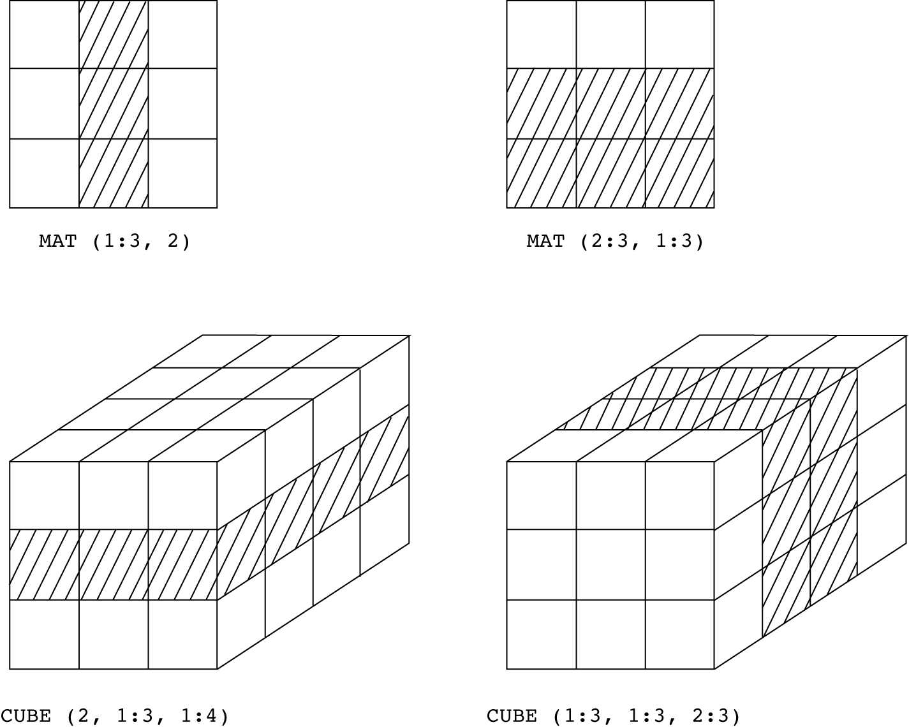
SLICES EXAMPLES IN FORTRAN 95
1-<number>

Slide 37
IMPLEMENTATION OF ARRAYS
Access function maps subscript expressions to an address in the array
Access function for single-dimensioned arrays:
address(list[k]) = address (list[lower_bound])
+ k * element_size
1-<number>

Slide 38
POINTER AND REFERENCE TYPES
A pointer type variable has a range of values that consists of memory addresses and a special value, nil
Advantages of pointers:
  Provide the power of indirect addressing
  Provide a way to manage dynamic memory
A pointer can be used to access a location in the area where storage is dynamically created (usually called a heap)
1-<number>

Slide 39
DESIGN ISSUES OF POINTERS
What are the scope of and lifetime of a pointer variable?
What is the lifetime of a heap-dynamic variable?
Are pointers restricted as to the type of value to which they can point?
Are pointers used for dynamic storage management, indirect addressing, or both?
Should the language support pointer types, reference types, or both?
1-<number>

Slide 40
POINTER OPERATIONS
Two fundamental operations: assignment and dereferencing
Assignment is used to set a pointer variable’s value to some useful address
Dereferencing yields the value stored at the location represented by the pointer’s value
  Dereferencing can be explicit or implicit
  C++ uses an explicit operation via *
  j = *ptr
  sets j to the value located at ptr
1-<number>

Slide 41
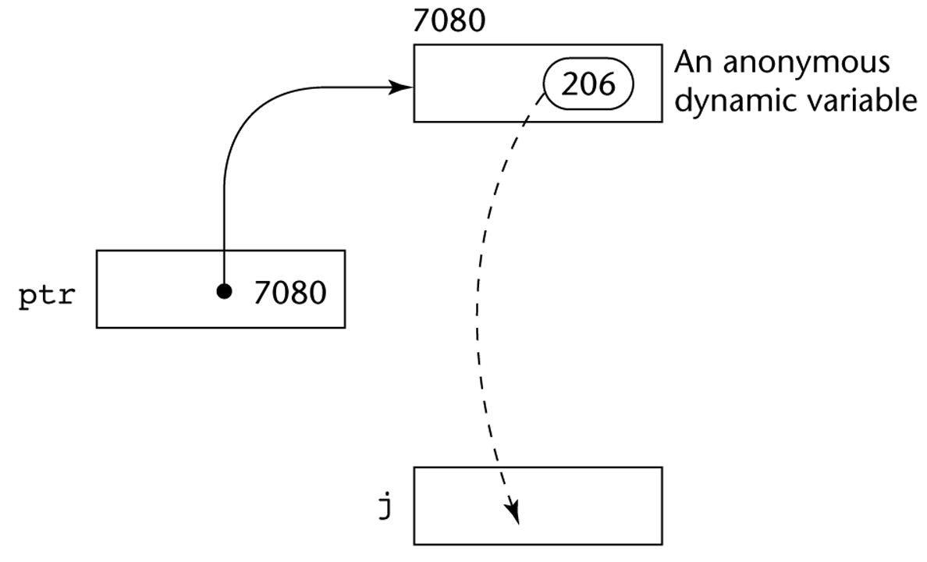
POINTER ASSIGNMENT ILLUSTRATED
The assignment operation j = *ptr
1-<number>

Slide 42
PROBLEMS WITH POINTERS
Dangling pointers (dangerous)
  A pointer points to a heap-dynamic variable that has been de-allocated
  Dangerous for several reasons because location being pointed to may have been reallocated to some new heap-dynamic variable.
  Example:
    int *arrayPtr1;
    int *arrayPtr2 = new int[100];
    arrayPtr1 = arrayPtr2;
    delete [] arrayPtr2;
1-<number>

Slide 43
PROBLEMS WITH POINTERS
Lost heap-dynamic variable
  An allocated heap-dynamic variable that is no longer accessible to the user program (often called garbage or memory leakage)
    Pointer p1 is set to point to a newly created heap-dynamic variable
    Pointer p1 is later set to point to another newly created heap-dynamic variable
1-<number>

Slide 44
POINTERS IN ADA
Some dangling pointers are disallowed because dynamic objects can be automatically de-allocated at the end of pointer's type scope
The lost heap-dynamic variable problem is not eliminated by Ada
1-<number>

Slide 45
POINTERS IN C AND C++
Extremely flexible but must be used with care
Pointers can point at any variable regardless of when it was allocated
Used for dynamic storage management and addressing
Pointer arithmetic is possible
Explicit dereferencing and address-of operators
Domain type need not be fixed (void *)
void * can point to any type and can be type checked (cannot be de-referenced)
1-<number>

Slide 46
POINTER ARITHMETIC IN C AND C++
float stuff[100];
float *p;
p = stuff; // assign address of stuff[0] to p
*(p+5) is equivalent to stuff[5] and p[5]
*(p+i) is equivalent to stuff[i] and p[i]
1-<number>

Slide 47
REFERENCE TYPES
Similar to pointer except that it is referring to an object or a value in memory rather than an address.
C++ includes a special kind of pointer type called a reference type that is used primarily for formal parameters
  Advantages of both pass-by-reference and pass-by-value
Java extends C++’s reference variables and allows them to replace pointers entirely
  References refer to call instances
C# includes both the references of Java and the pointers of C++
1-<number>

Slide 48
EVALUATION OF POINTERS
Dangling pointers and dangling objects are problems as is heap management
Pointers are like goto's--they widen the range of cells that can be accessed by a variable
Pointers or references are necessary for dynamic data structures--so we can't design a language without them
1-<number>

Slide 49
TYPE CHECKING
Generalize the concept of operands and operators to include subprograms and assignments
  Subprogram as operator, parameters as operands
  Assignment symbol as binary operator, target variable and expression as operands
Type checking is the activity of ensuring that the operands of an operator are of compatible types
A compatible type is one that is either legal for the operator, or is allowed under language rules to be implicitly converted, by compiler- generated code, to a legal type
  This automatic conversion is called a coercion. For example, adding an int to a float in Java causes int to be coerced to float
1-<number>

Slide 50
TYPE CHECKING (CONTINUED)
A type error is the application of an operator to an operand of an inappropriate type. For examples, in passing values to functions.
If all type bindings are static, nearly all type checking can be static
If type bindings are dynamic, type checking must be dynamic
A programming language is strongly typed if type errors are always detected
1-<number>

Slide 51
STRONG TYPING
Advantage of strong typing: allows the detection of the misuses of variables that result in type errors
Language examples:
  FORTRAN 77 is not: parameters, EQUIVALENCE
  Pascal is not: variant records
  C and C++ are not: unions are not type checked
  ML is strongly typed
  Ada is, almost: type checking can be suspended with the calling of function Unchecked_Conversion. Java and C# are similar.
1-<number>

Slide 52
STRONG TYPING (CONTINUED)
Coercion rules strongly affect strong typing--they can weaken it considerably (C++ versus Ada)
Languages with a great deal of coercion, like Fortran, C, and C++ are les reliable than those with little coercion, such as Ada.
Although Java has just half the assignment coercions of C++, its strong typing is still far less effective than that of Ada
1-<number>

Slide 53
TYPE EQUIVALENCE
Type compatibility influences the design of the data types and the operation provided for values of those types.
Two different types of compatibility methods :
  Name type equivalence
  Structure type equivalence
1-<number>

Slide 54
NAME TYPE EQUIVALENCE
Name type equivalence means the two variables have compatible types if they are in either the same declaration or in declarations that use the same type name
Easy to implement but more restrictive:
  Subranges of integer types are not equivalence with integer types. In the following example, types of variable count and index are not equivalence.
    type Indextype is 1..100;
    count : Integer;
    index : Indextype;
  Formal parameters must be the same type as their corresponding actual parameters, especially user-defined types.
1-<number>

Slide 55
STRUCTURE TYPE EQUIVALENCE
Structure type equivalence means that two variables have compatible types if their types have identical structures
More flexible, but harder to implement because the entire structures of the two types must be checked for equivalence.
1-<number>

Slide 56
STRUCTURE TYPE EQUIVALENCE (CONTINUED)
Consider the problem of two structured types:
  Are two record types equivalent if they are structurally the same but use different field names?
  Are two array types equivalent if they are the same except that the subscripts are different?
  (e.g. [1..10] and [0..9])
  Are two enumeration types equivalent if their components are spelled differently?
  With structural type equivalence, you cannot differentiate between types of the same structure (e.g. different units of speed, both float)
1-<number>

Slide 57
SUMMARY
The data types of a language are a large part of what determines that language’s style and usefulness
The primitive data types of most imperative languages include numeric, character, and Boolean types
The user-defined enumeration and subrange types are convenient and add to the readability and reliability of programs
Arrays and records are included in most languages
Pointers are used for addressing flexibility and to control dynamic storage management
1-<number>

